Slide 1



This is Anglican Sponsorship
A brief overview of refugee sponsorship across the Anglican Church of Canada
Notes:
How does God’s love abide in anyone who has the world’s goods and sees a brother or sister in need and yet refuses help? Little children, let us love, not in word or speech, but in truth and action.
1 John 3: 17-18

Slide 2
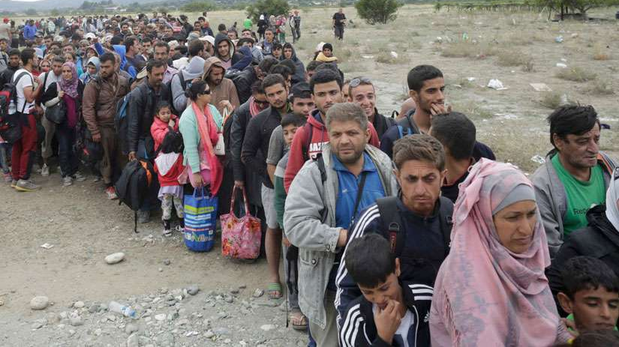
Who is a Refugee?
Forced to flee their country of origin because
of persecution, war or violence
They have a well-founded fear of persecution based on:
  Race
  Religion
  Nationality
  Political Opinions
  Membership in particular social group

Slide 3
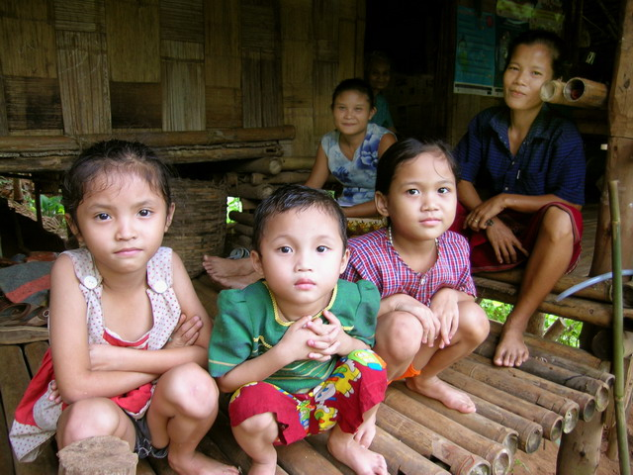
Durable Solutions
The UNHCR considers there to be 3 solutions for refugees:
Voluntary Repatriation
  returning home
Local Integration
  integrating into the country of asylum
→ Resettlement ←
  permanent move to a “third” country
Photo: UNHCR

Slide 4
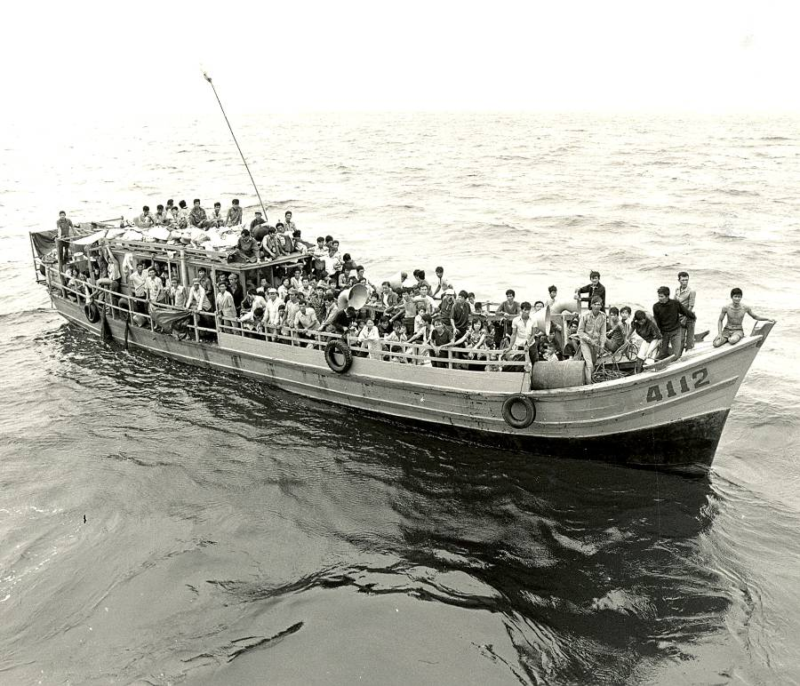
A Brief History: Origins
In 1979 Canadians enthusiastically applied to sponsor Vietnamese refugees – often referred to as ‘Boat People’ under the new Private Sponsorship of Refugees Program
This was in addition to the government’s sponsorship efforts
Canada’s private sponsorship program is unique! Over 390,000 refugees have been sponsored in the last 40 years
Photo: UNHCR

Slide 5
ANGLICAN Sponsorship Agreement Holders
Diocese of Islands and Inlets
Diocese of New Westminster
Diocese of Kootenay
Diocese of Edmonton
Diocese of Calgary
Diocese of Saskatoon
Diocese of Qu'Appelle
Diocese of Rupert's Land
Diocese of Huron
Diocese of Niagara
Diocese of Toronto
(through AURA)
Diocese of Ontario
Diocese of Ottawa
Diocese of Montreal
(through
Action Refugies)
Diocese of Nova Scotia & PEI
Notes:
15 Anglican SAHS

Slide 6
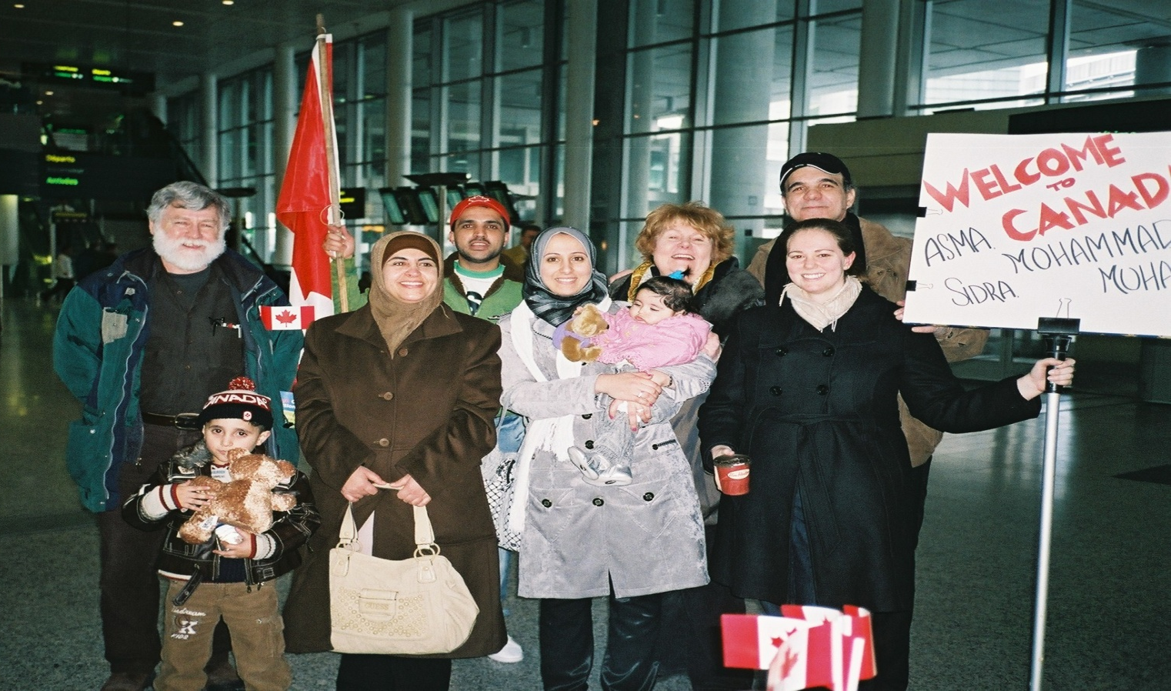

An Anniversary Observed
In 2010 to mark its 50th Anniversary, the Primate’s World Relief & Development Fund set a goal to sponsor 50 refugee families
Seed funding helped parishes undertake sponsorships, often for the first time
A family sponsored by two churches in Dundas and Flamborough in 2010

Slide 7
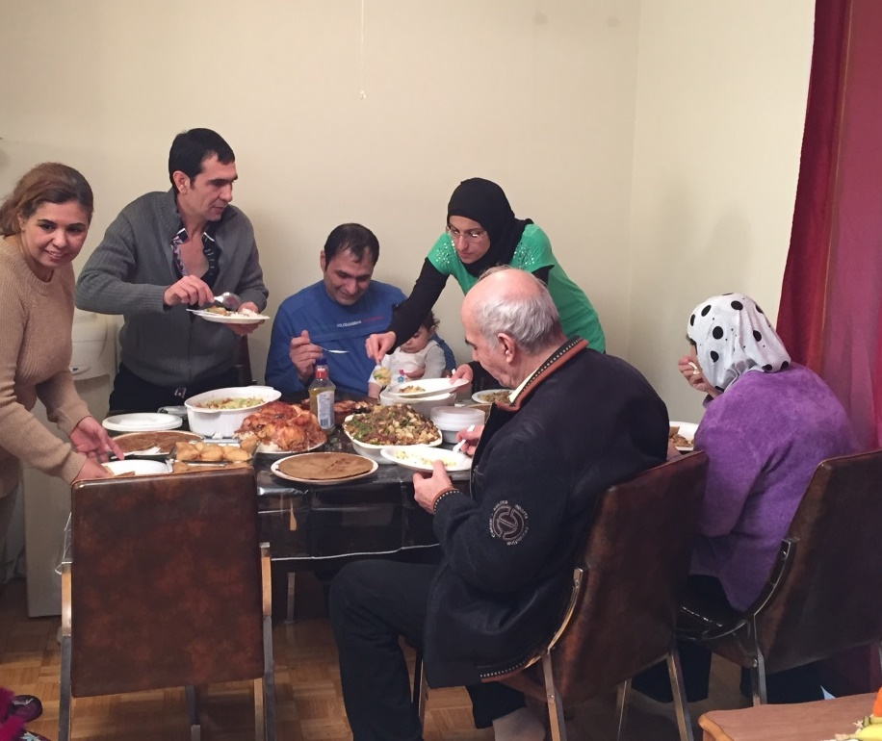
The Syrian Refugee Crisis
The Government of Canada resettled 25,000 Syrian refugees between November 2015 and February 29, 2016.
Anglicans, often working with community groups unaffiliated with the Church, sponsored thousands of Syrian refugees and welcomed them to our communities from coast to coast to coast
Even more refugees have been sponsored in the years since
Photo: Diocese of Niagara

Slide 8
The Basics of Sponsorship
Government of Canada
Sponsorship Agreement Holders (Dioceses)
Sponsorship Group
Newcomers (former refugees)
Notes:
Goal: support the newcomer’s integration to Canadian life in a way that will see them flourish and live with dignity
A sponsorship group is responsible for the resettlement of a refugee(s) to Canada, in which 12 months of settlement support is provided and/or facilitated by parish volunteers who companion the newcomer(s) as they integrate into your community.
Diocesan support will be provided throughout the discernment and settlement periods, and the sponsorship will happen under the Diocese’s agreement with Citizenship & Immigration Canada.
The government oversees the entire resettlement process.

Slide 9

Countries of Origin
Afghanistan
Burundi
Democratic Republic
of the Congo
Eritrea
Ethiopia
Georgia
Iran
Iraq
Liberia
Myanmar
Pakistan
Palestine
Sierra Leone
Somalia
South Sudan
Sudan
Syria
Ukraine
Venezuela
Yemen
Notes:
Afghanistan, Syria and Eritrea are three countries which mosts SAHs have sponsorships from.
Overall responsibility and liability for the sponsorship
Training, advice, and paperwork assistance
Monitoring
Sponsors provide financial, social, and emotional support for the refugees for the duration of the sponsorship
Sponsorships formally last for 12 months or until the refugee becomes financially independent, whichever comes first
Informal support often carries on beyond the sponsorship period

Slide 10
What Does Sponsorship Involve?
Arranging Temporary Accommodation
Finding Permanent Accommodation
Airport Welcome
Orientation to Canada
Providing Furniture, Clothing, and Supplies
Application Forms
Find Doctors and Dentists
Facilitate Community
Connections
Applying for IFH (Integral Federal Health)
Build a resume,
Find a job
Enroll in ESL
Apply for a SIN card
Learning Canadian Rights & Customs
Enroll Children in School
Apply for Child Tax Benefit
Find Trauma Counselling
Opening Bank Accounts
Prayer
Providing Emotional and Moral Support
Notes:
housing accommodation;
education and ESL training;
health and dental care;
social and cultural integration;
furniture, clothing and food;
immigration and other administrative services required for the refugees' resettlement in Canada;
employment opportunities; and
recreation

Slide 11
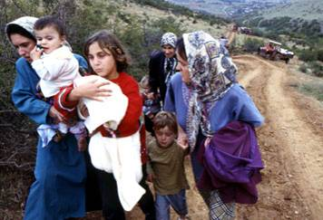
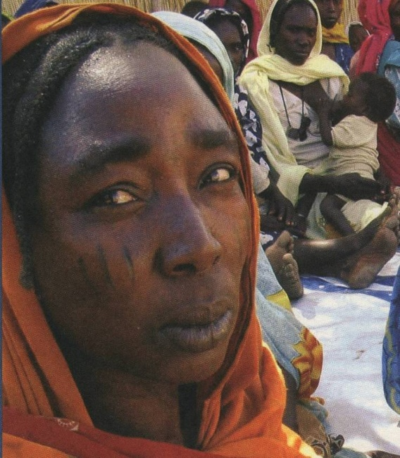
This Is about People,
Our Global neighbours
Mid-2023 there were over
110 million
forcibly displaced persons worldwide
36.4 million
are refugees, similar to
Canada’s total population
Photo: UNHCR
52% originate from three countries:
Syria, Afghanistan, Ukraine
Photo: UNHCR

Slide 12
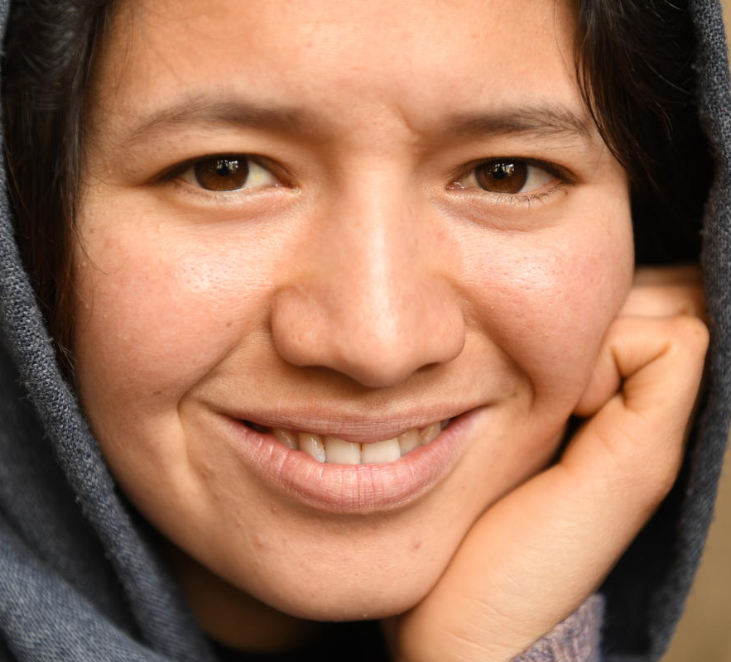
Why We Sponsor
Jesus—himself a refugee—invites us to ministry that transforms lives
With conflict and crises increasing, the need to resettle refugees has never been greater
Sponsoring a refugee not only changes their life, it changes everyone’s life
© UNHCR/Farzana Wahidy
Notes:
They focus together on compassion and love, looking outside of themselves rather than dwelling on internal problems
They connect with others in their community, demonstrating the power of God’s love
They have an opportunity to grow and transform. They develop team cohesiveness, learn from new experiences, and discover untapped resources
They appreciate life in Canada through someone else’s eyes

Slide 13
This is Anglican Sponsorship
A brief overview of refugee sponsorship across the Anglican Church of Canada
Notes:
How does God’s love abide in anyone who has the world’s goods and sees a brother or sister in need and yet refuses help? Little children, let us love, not in word or speech, but in truth and action.
1 John 3: 17-18

