Slide 1


Coming Alongside Hope With Light
You Can Provide Light to Off-Grid Health Clinics in Mozambique and Madagascar

Slide 2
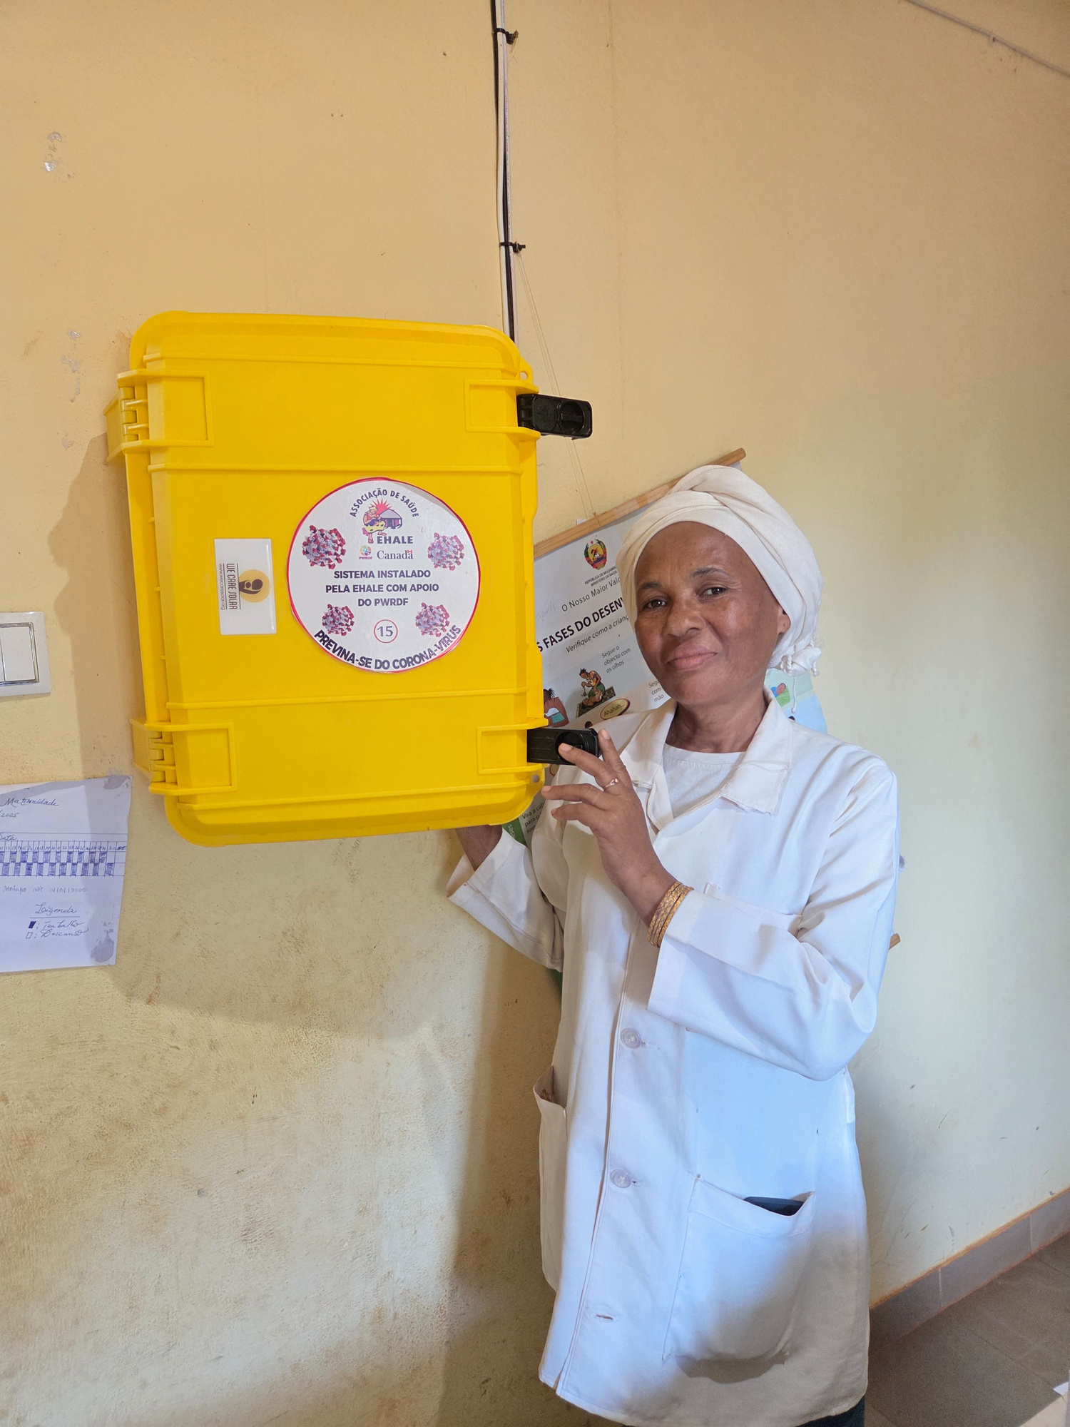
Light that Saves Lives
Churches and individuals across Canada are coming together to raise $170,000 to deliver 49 solar suitcases to off-grid health clinics in Mozambique and Madagascar, where babies are often delivered at night, in the dark.
And God said, “Let there be light… and that light was good.” – Genesis 1:3
A midwife shows the solar suitcase hanging on the clinic wall.
Alongside Hope

Slide 3
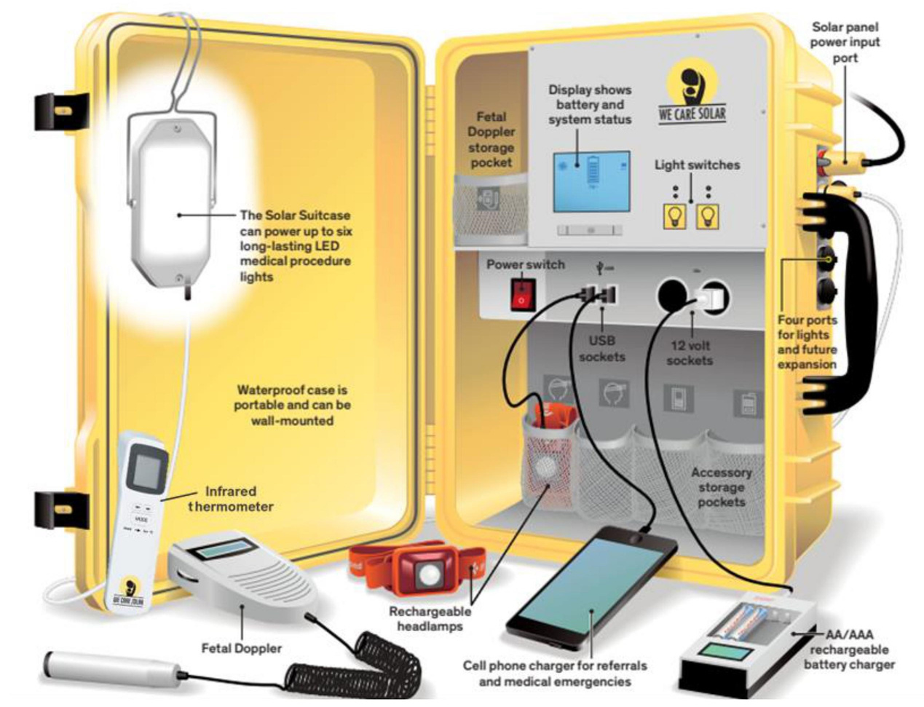
These units bring life-saving light and
medical equipment
The case is mounted on a clinic wall. It’s connected to a solar panel on the roof, and powered by the sun. It holds everything a birth attendant needs to support a safe delivery: bright LED lights, a fetal Doppler, headlamps, phone chargers - real peace of mind for labouring women. With your help, these solar suitcases can change lives.
Alongside Hope
The inside of a solar suitcase.

Slide 4
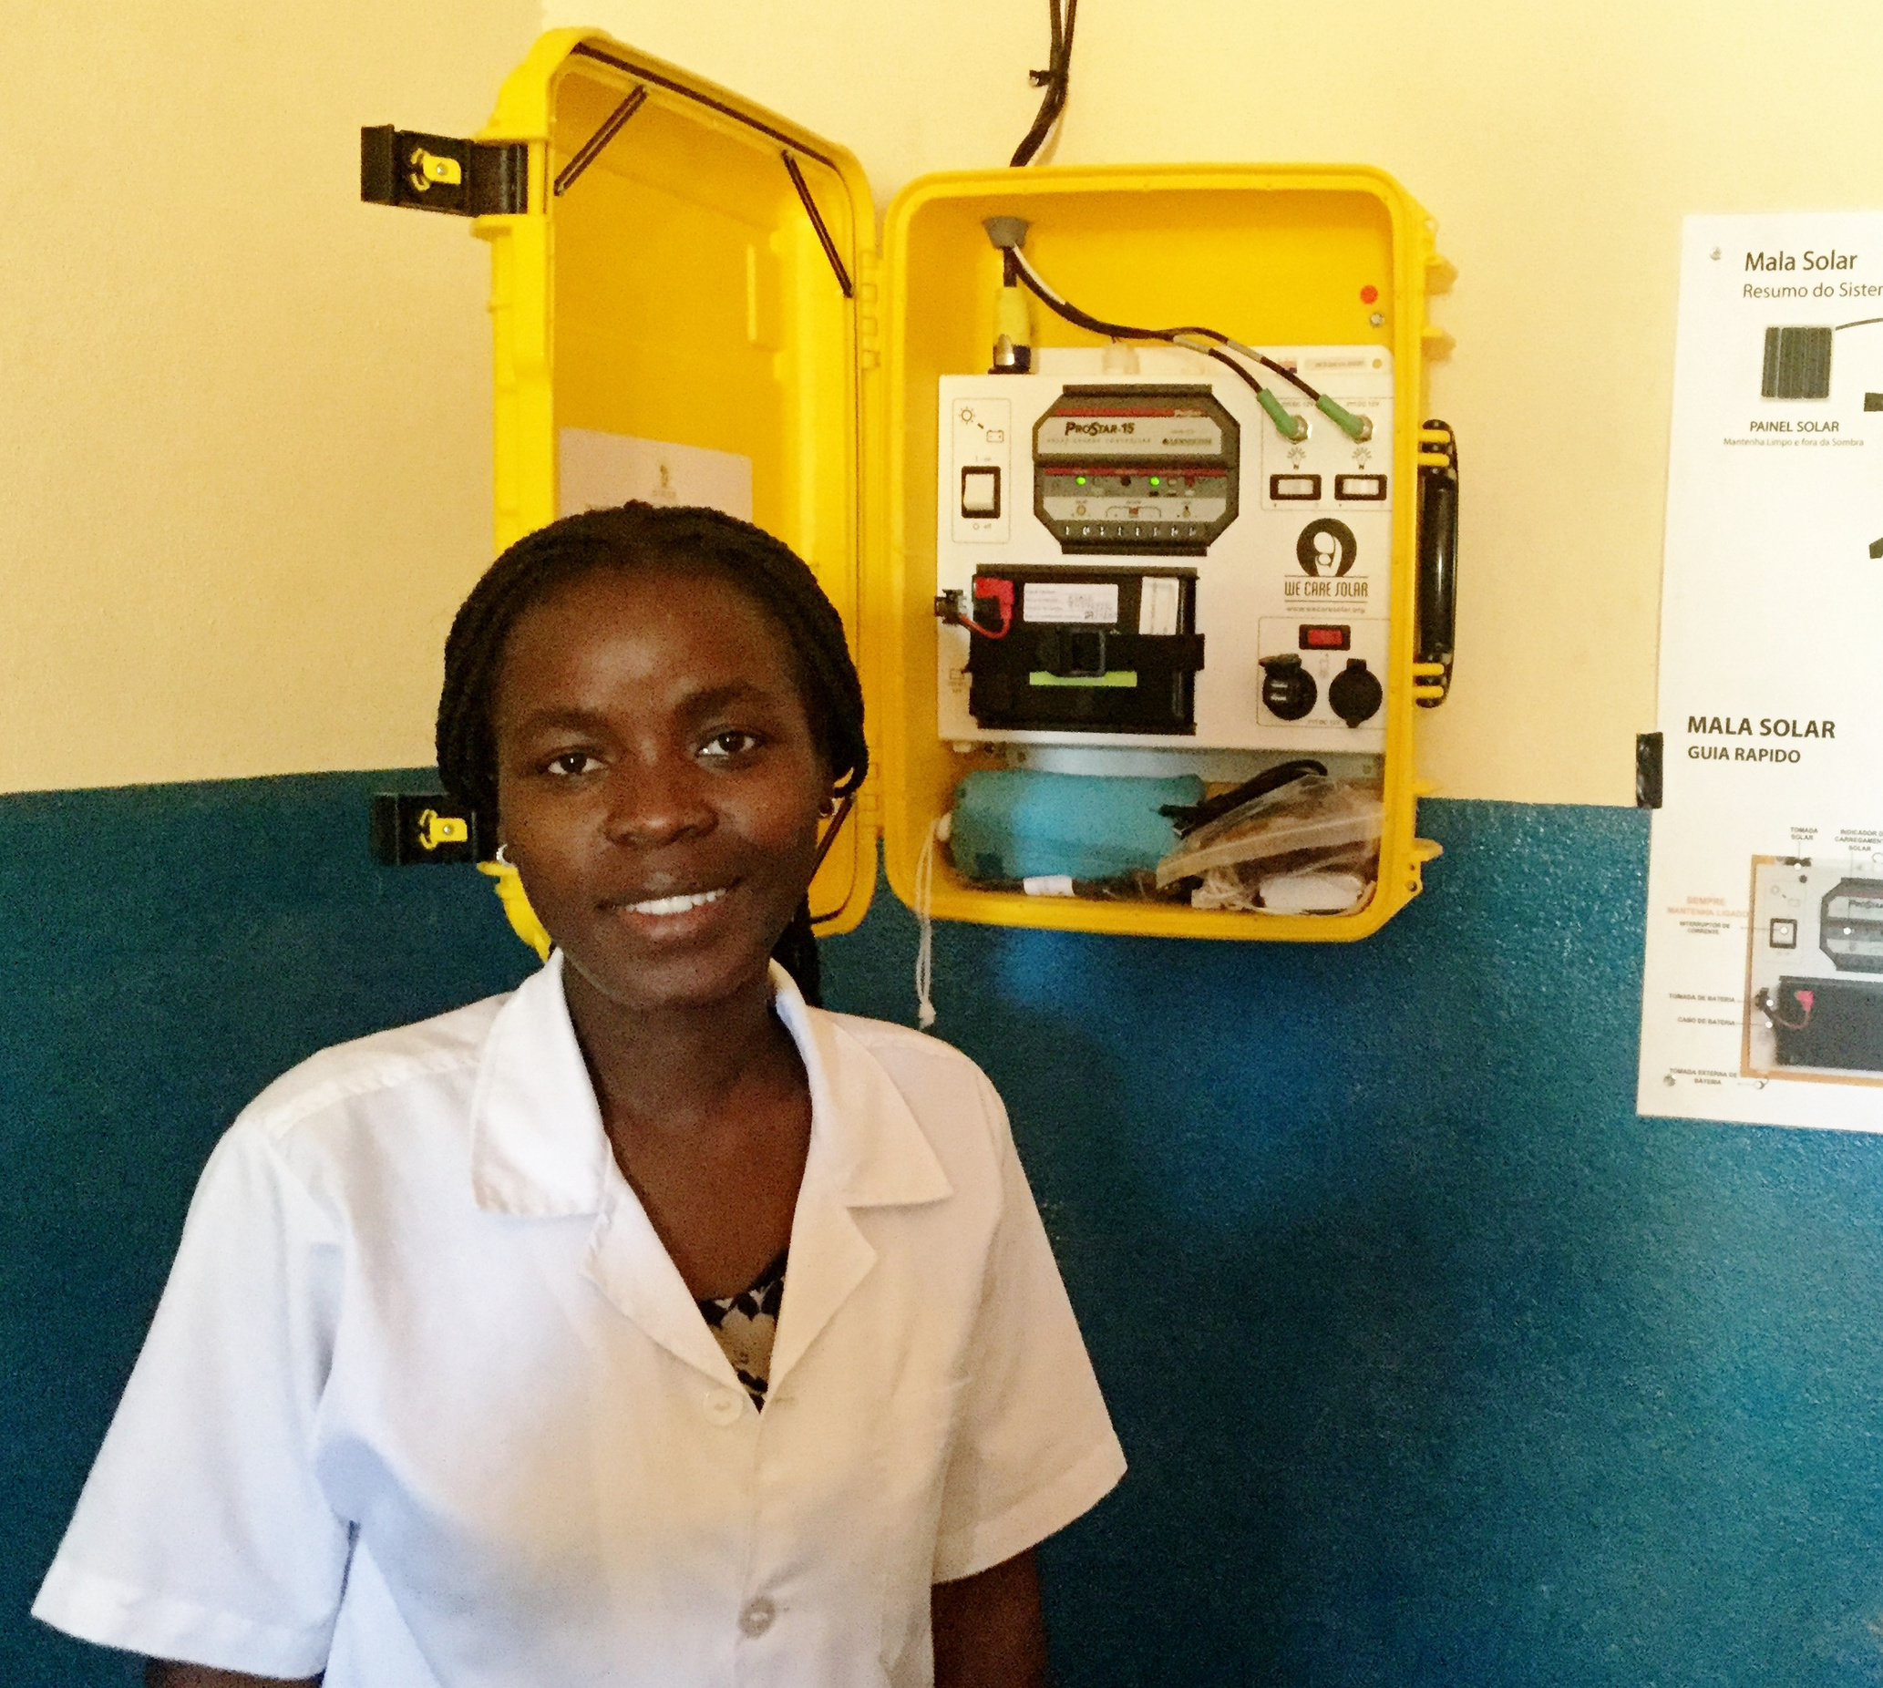
Solar Suitcases Work.
Since our first installations in 2016, more than 80,000 babies have been safely delivered in off-grid clinics.
🔋 Light means safer births.
💡 Light means stronger care.
❤️ Light means hope.
A health care worker shows the solar suitcase hanging on the clinic wall.

Slide 5
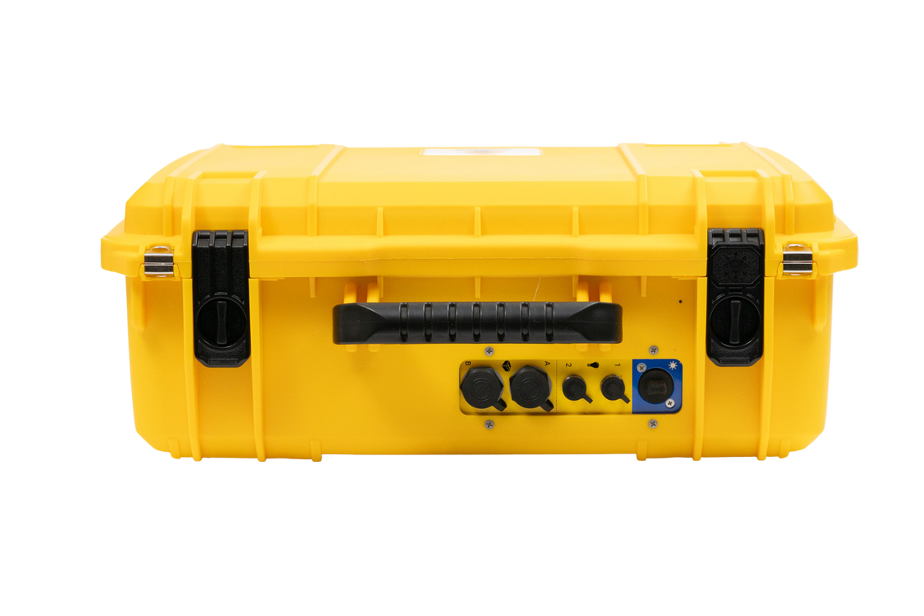
Every Dollar You Give Will Be Doubled
– up to $150,000 – thanks to a generous matching gift.
Together we can install 35 solar suitcases in Mozambique and 14 in Madagascar, bringing clean, reliable power to 49 clinics where women and babies deserve the very best care, no matter the hour.
And when you donate, your gift will go twice as far.
The outside of a solar suitcase.
Alongside Hope

Slide 6
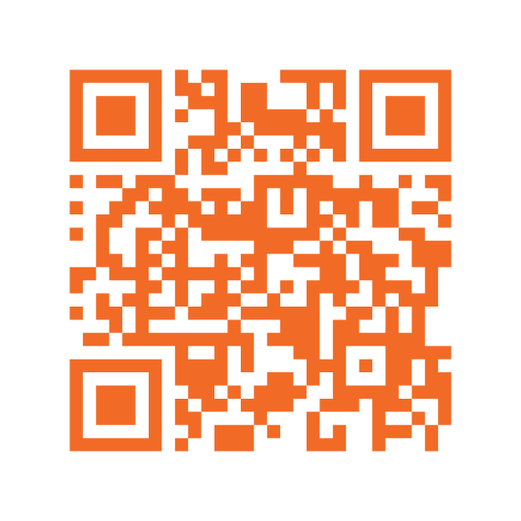
Be the spark.
Give today.
Donate now and bring life-giving light to women and babies. Learn more and donate today.
Scan the QR code or visit,
alongsidehope.org/solar-suitcase
Alongside Hope

Slide 7
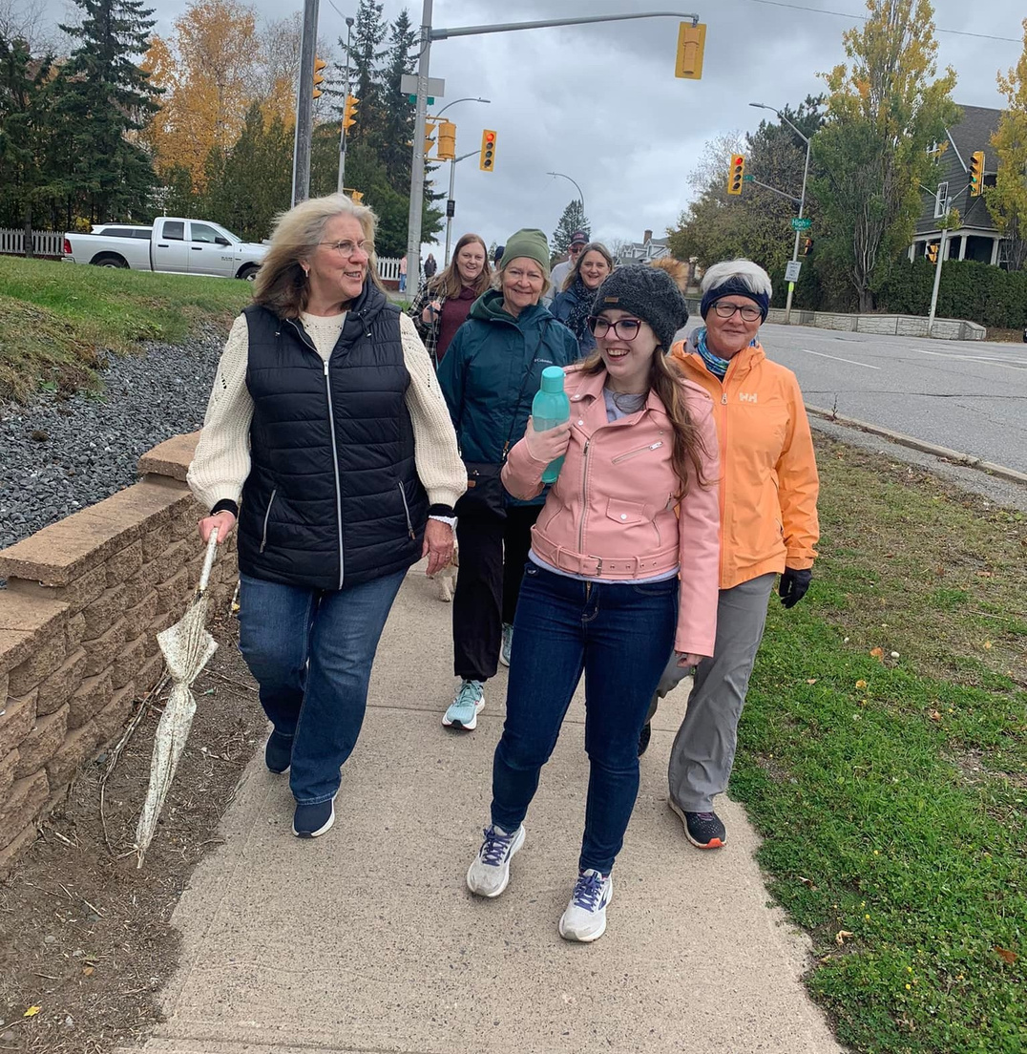
Your Church Can Raise Donations Together
There are many ways your church can come together to raise money for solar suitcases. Ideas include:
  A Fundraiser like an ice cream social, BBQ, or homemade goods sale.
  Sponsor a Suitcase Campaign: set a goal (e.g., $6,500 to fund one Solar Suitcase) and track progress visually in the church and/or bulletin. Bonus: Ask a church member or local business to match donations up to a set amount to inspire others to give.
  “Buy a Lightbulb” Drive through your church and greater community: Symbolically sell lightbulbs for $25 or $50 each. Create a display - maybe outside to light the night - and show how many have been "lit" by gifts.
  Special Offering Sunday: dedicate a Sunday offering to solar suitcase.
St. Paul's Anglican Church, Thunder Bay, ON, is joining the Thunder Bay- North Shore Deanery walk to raise funds and awareness of solar suitcases.
Alongside Hope

Slide 8
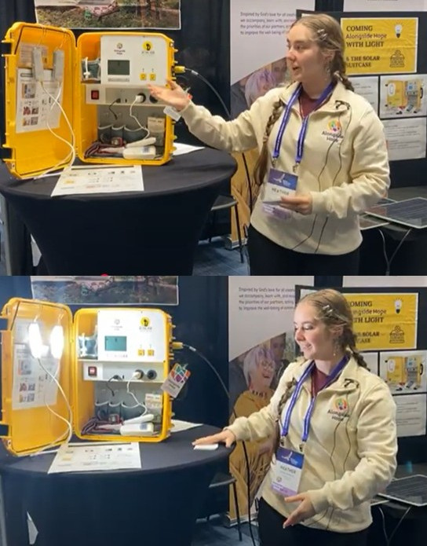

BOGO: Buy One, Get One
Remember, all donations raised up to $150,000 will be matched.
So, if your church raises $6,500 to purchase a solar suitcase, it’s like buying TWO!
Heather Wilks Jenkins, Alongside Hope Summer Intern, demonstrates the solar suitcase at General Synod, 2025.
‹#› | Alongside Hope

Slide 9

You Can Join Alongside Hope’s 4th Annual Wild Ride and Support the Purchase of Solar Suitcases.
Whether you walk, cycle, roller blade, bake, read, knit, swim, canoe, dance, or invent your own way, you’re invited to join others across Canada in a joyful movement of hope to raise donations for solar suitcases. You can participate solo or gather together a team.
Your activity, your pace, your purpose—united for something greater
Alongside Hope

Slide 10
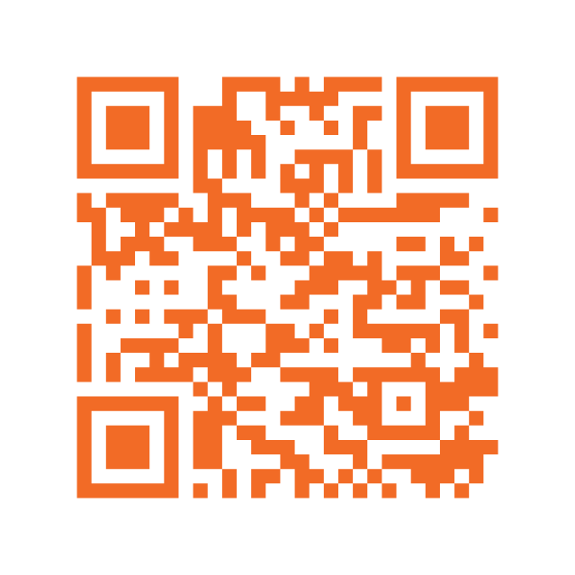
Last year’s Wild Ride was a wild success with 19 teams and 62 participants joining forces to raise $53,000.
This year we want to raise $52,000 for the purchase of 8 solar suitcase, and with the matching gift, that means 16 solar suitcases!
Learn more by or scanning the QR code or visit,
alongsidehope.org/wild-ride
Alongside Hope

Slide 11
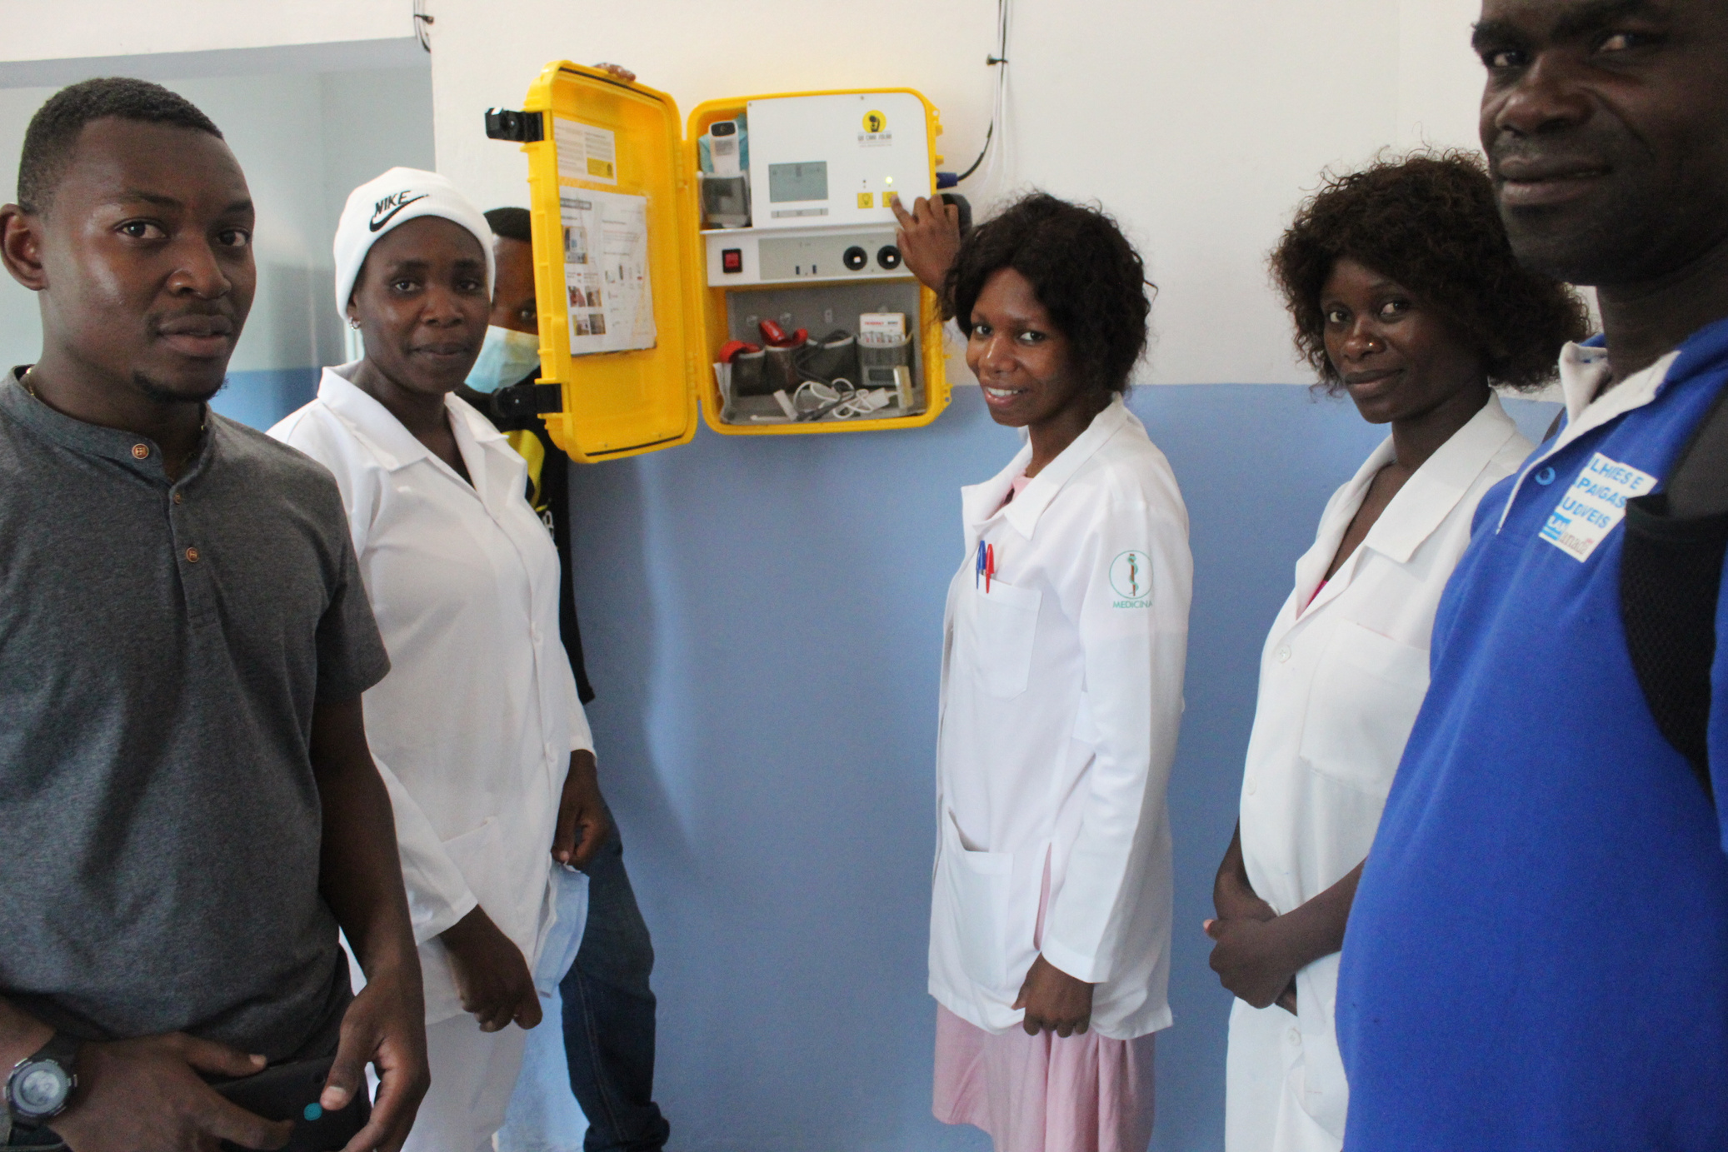
Let’s turn on the power for safe births, together.
Midwives and health care workers show their solar suitcase.
Alongside Hope

